Slide 1
ANCIENT WATER MANAGEMENT AND IRRIGATION METHODS (South India)
MADE BY:

Slide 2
ANCIENT WATER MANAGEMENT
(SOUTH INDIA)

Slide 3
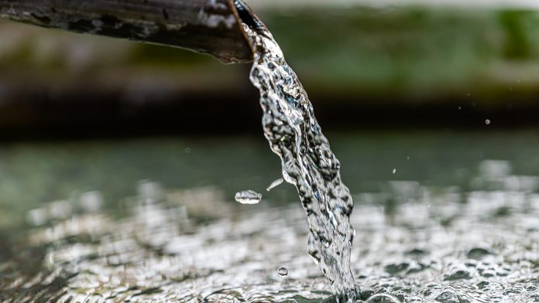
What is water management?
Water Management is the activity of planning, developing, distributing and optimum use of water resources under defined water polices and regulations.
It includes:
1) Management of water treatment of drinking water
2) Industrial water, sewage or wastewater
3) Management of water resources
4) Management of flood protection
5) Management of irrigation
6) Management of the water table

Slide 4
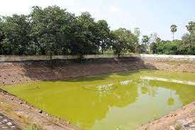
Ancient management of drinking water
Ooranis are small ponds that have collected rainwater from rains and from surrounding catchment areas. These Ooranis traditionally were used for various needs of drinking, washing, bathing needs of the villages around it.
In kerala, temple played important roles by harvesting their surplus water in tanks; associated with which is “sacred grove”(‘Kaavu’).
These tanks were clean due to their restricted use therefore these were converted in portable water resources for few neighboring localities after passing through a simple and slow sand filter.

Slide 5
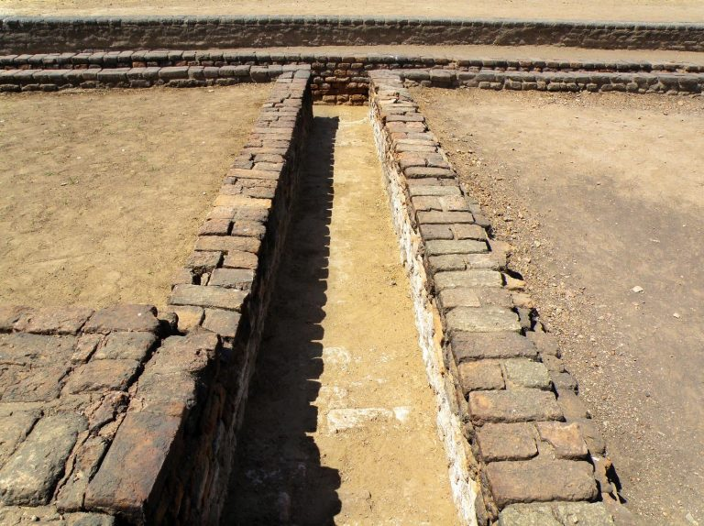
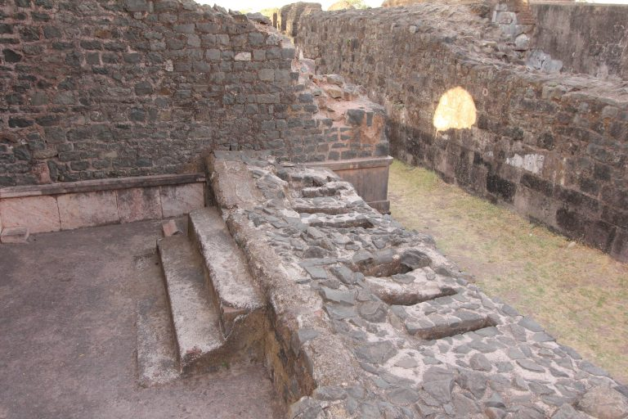
Industrial water, sewage or wastewater
There is a mistaken belief that urban wastewater management systems were only found in Indus-Sarasvati civilization. In fact, terracotta pipes and brick lined soak pits have been found in Takshshila, Delhi, Ujjain and Arikamedu, which are all located in different parts of India. Arikamedu(Puducherry), which was a noted centre for textile production has the unique distinction of featuring industrial wastewater systems dating to the first century before the common era.

Slide 6
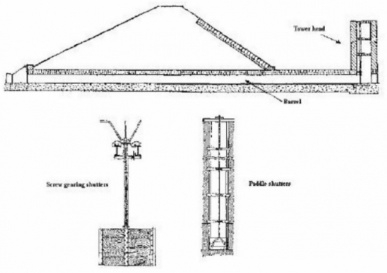
Management of water resources
Since in ancient times facilities of getting underground water resources in every house through submersible pumps, motors. Preventing overflow of lakes water was very important for safety as well.
The Kalingu or surplus weir is the most important component of a tank. The surplus escape is the safety valve of the tank. Usually, the escape was located on the extreme end of a tank. If a tank was formed across a stream, the weir will be higher than if located on the stream and will also be costlier. Providing dam stones for the surplus weir was a common practice followed for centuries until recently in Tamil Nadu.

Slide 7
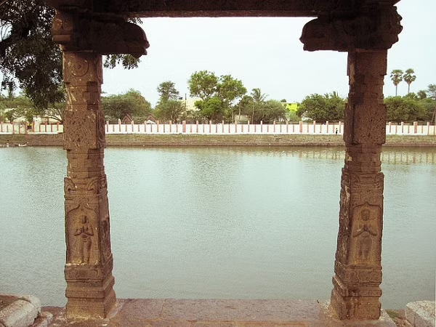
Management of flood protection
The Eri (tank) system of Tamil Nadu is one of the oldest water management systems in India. Still widely used in the state, eris act as flood-control systems, prevent soil erosion and wastage of runoff during periods of heavy rainfall, and also recharge the groundwater. Eris can either be a system eri, which is fed by channels that divert river water, or a non-system eri, that is fed solely by rain. The tanks are interconnected in order to enable access to the farthest village and to balance the water level in case of excess supply.

Slide 8
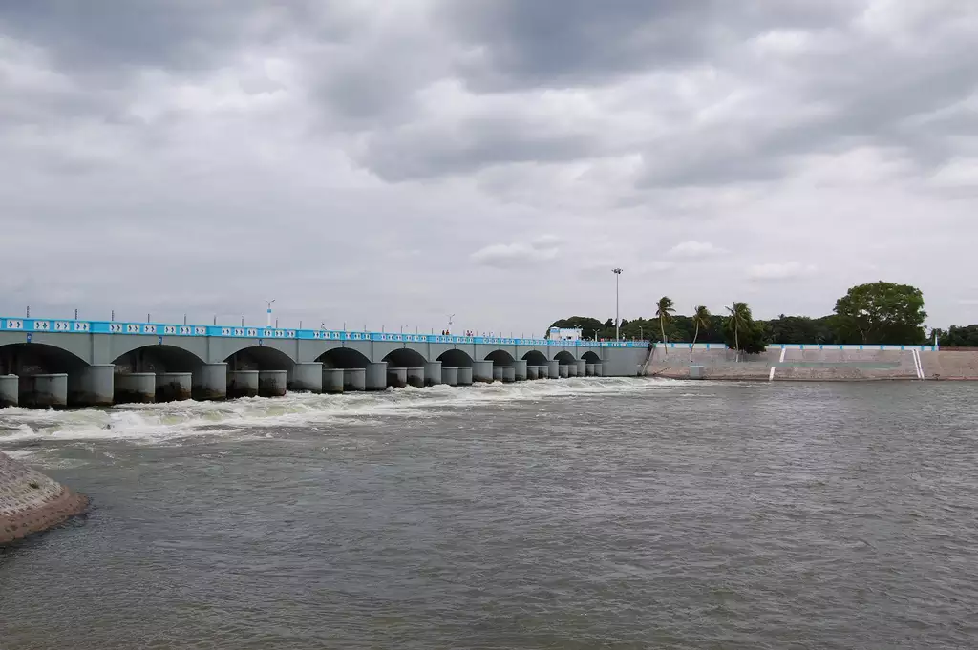
Management of irrigation
In Southern India, perennial agriculture became common with the construction of the Grand Anicut dam. Additionally Chola kingdom also introduced the tank irrigation system. This topic will be further explained in upcoming slides.

Slide 9
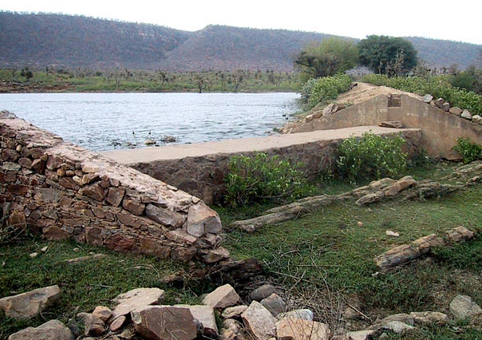
Management of the water table
Johads, one of the oldest systems used to conserve and recharge ground water, are small earthen check dams that capture and store rainwater. Constructed in an area with naturally high elevation on three sides, a storage pit is made by excavating the area, and excavated soil is used to create a wall on the fourth side. Sometimes, several johads are interconnected through deep channels, with a single outlet opening into a river or stream nearby. This prevents structural damage to the water pits that are also called madakas in Karnataka and pemghara in Odisha.

Slide 10
Irrigation Methods
(SOUTH INDIA)

Slide 11
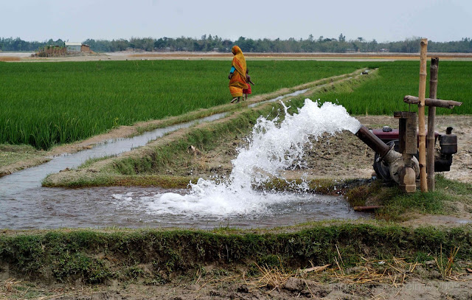
What is irrigation?
Irrigation is the agricultural process of applying controlled amounts of water to land to assist in the production of crops, as well as to grow landscape plants and lawns, where it may be known as watering. Agriculture does not rely only on direct rainfall but also on other resources of water.
Irrigation helps to grow agricultural crops, maintain landscapes, and revegetate disturbed soils in dry areas and during periods of less than average rainfall. Irrigation also has other uses in crop production, including frost protection, suppressing weed growth in grain fields and preventing soil consolidation.

Slide 12
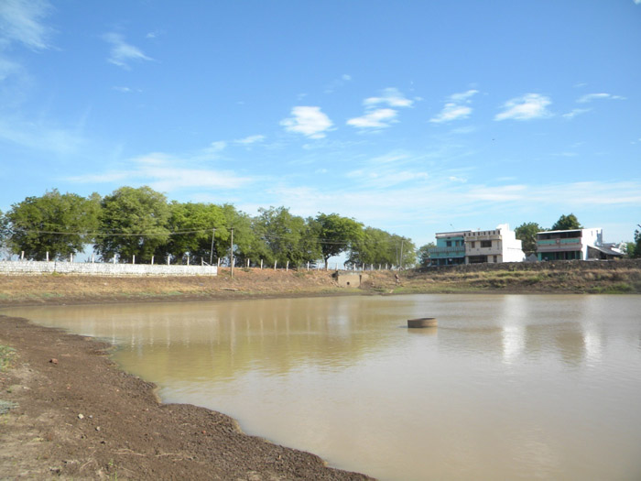
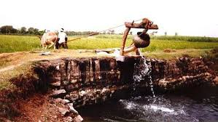
Irrigation methods
Some of the ancient irrigation methods in south India are as follows:-
Eri (Tamil Nadu)
Surangam and Korambu (Kerala)
Katta and madaka (Karnataka)

Slide 13
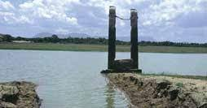
Eri (Tamil Nadu)
There are no perennial rivers in Tamil Nadu except the one River which flows through Thirunelveli district. And so, several hundred years ago a simple system was devised to utilize the rainwater to the fullest. An Eri or tank system is one of the oldest forms of water conservation systems in India.
Approximately one-third of the irrigated area of Tamil Nadu is watered by eris (tanks). Eris have played several important roles in maintaining ecological harmony as flood-control systems, preventing soil erosion etc. The presence of eris provided an appropriate micro-climate for the local areas. Without eris, paddy cultivation would have been impossible. Till the British arrived, local communities maintained eris.

Slide 14
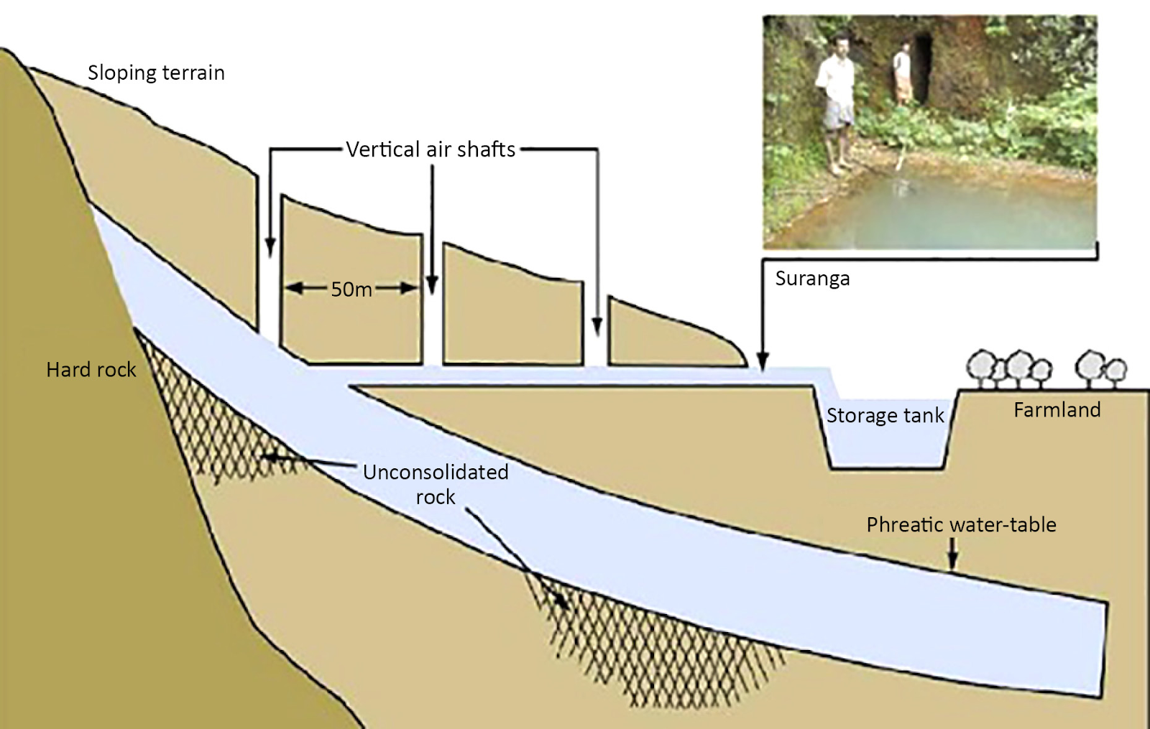
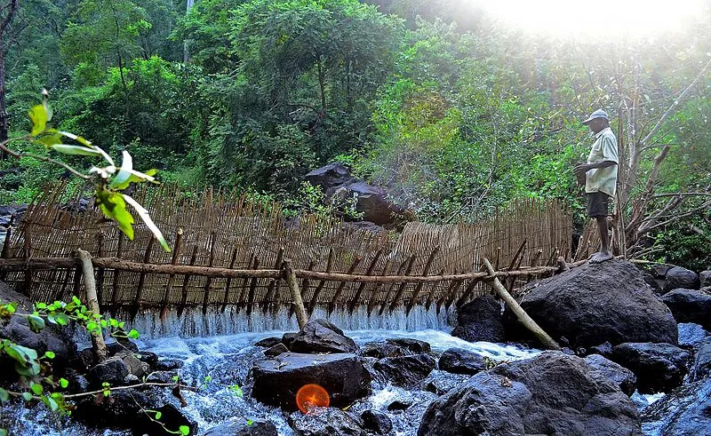
Surangam and Korambu (Kerala)
Surangam are tunnels that divert the water away from a well that is dug deep into the ground. The practice was widely used in Kerala. At the mouth of the surangam, a reservoir is constructed to provide a reliable supply of water for human settlements and irrigation
Korambu is a temporary dam stretching across the mouth of channels, manufactured from brushwood, mud and grass. Korambu is made to boost the water level within the canal and to divert the water into field channels. Water is allowed to result one field to a different till all the sector are irrigated.

Slide 15
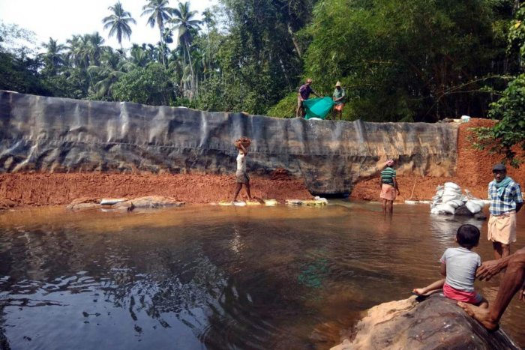
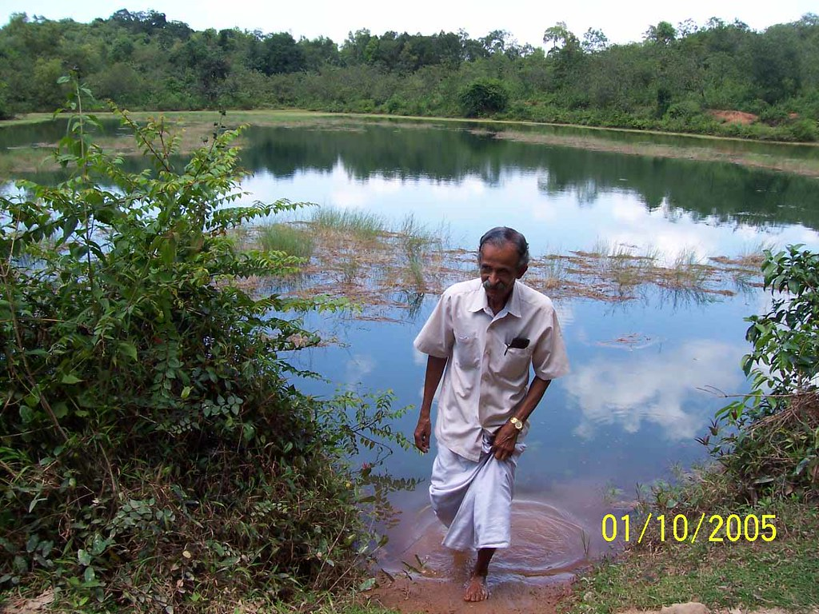
Katta and madaka (Karnataka)
Katta is a traditional method of water conservation used in parts of Kerala and Karnataka. These are structures built across rivulets and streams. It is a series of check dams constructed along with diversion. Katta is not a permanent structure. It is built using locally available wood and kaccha stones. It needs to be built every year. Katta helps irrigate around 25 acres of areca nut fields and has improved the water table in a radius of six km.
Madaka is a traditional method of water conservation, typically constructed on the upper parts of undulating topography. It is not completely man-made. Natural slopes with bottlenecks are identified to assist in the construction. Earthen wall is constructed to hold the rainwater from running off to the sea.

Slide 16
Thank You
HAVE A NICE DAY !!!

